Slide 1

Week 7 — Interview Performance and Handling Difficult Questions
Strategies to excel and respond effectively under pressure
Notes:
AI-generated content may be incorrect. ---

Slide 2
Interview Skills Workshop
Notes:
Workshop Title Slide

Slide 3

Workshop Title Slide
Workshop Introduction
This workshop focuses on interview skills for IT and cybersecurity roles, emphasizing communication and problem-solving.
Professional Mindset
The slide sets a professional tone to help students adopt the right mindset for interview success.
Reducing Anxiety
Clear design and relevant visuals reduce anxiety and build student confidence before interviews.
Workshop Goals
Students are encouraged to view interviews as growth opportunities, not tests to fear.
Notes:
This slide introduces participants to the Week 7 workshop titled “Interview Performance and Handling Difficult Questions,” designed specifically for adult learners preparing for entry-level IT, cybersecurity, and help desk roles. The title slide sets the tone for a modern and engaging learning experience by presenting a clean, professional visual layout that mirrors real-world workplace expectations. It is important that students immediately recognize that interviews in IT and cybersecurity require not only technical knowledge but also strong communication and problem‑solving abilities. This slide therefore serves as a psychological entry point—helping students shift into a professional mindset as soon as the workshop begins. A strong visual design helps establish credibility, signals that the session will be structured and thoughtful, and reduces anxiety by providing clarity on what they are about to learn. In addition to title text, this slide may feature relevant professional imagery—such as icons representing communication, security, or technology—to align with the IT‑focused audience. The instructor can use this introduction to welcome the group, frame the importance of interview preparation, and preview the interactive, practical nature of the workshop. Students should be encouraged to view interviews not as tests to fear but as opportunities to demonstrate their potential and personal growth. This orientation supports adult learners who may be returning to education or transitioning careers, reminding them that preparation and confidence are powerful tools in navigating the hiring process.

Slide 4
Workshop Overview
Notes:
Agenda Overview

Slide 5

Agenda Overview
Workshop Structure
The agenda outlines the workshop structure, helping learners see how each part builds interview readiness.
Key Interview Topics
Focus areas include interview importance, hiring manager expectations, behavioral interviews, and the STAR method.
Skill Building Activities
Learners build a story bank, translate experiences, practice responses, and learn to address career pivots.
Supportive Learning Environment
The workshop includes interactive exercises and motivational close to empower participants.
Notes:
The agenda slide outlines the full structure of the workshop so learners can understand how each component contributes to their interview readiness. It introduces key areas such as why interviews matter, what hiring managers look for in entry‑level IT and cybersecurity roles, and how behavioral interviews help employers evaluate transferable skills. This slide highlights that the STAR method will serve as an anchor framework throughout the workshop, ensuring consistent practice and application. Learners will also see that they will build a story bank, learn how to translate previous non‑IT experience into the language of technical roles, and explore strategies for explaining career pivots and employment gaps. By previewing sections dedicated to answering strengths‑and‑weaknesses questions, discussing failures, and reviewing a structured interview preparation checklist, students gain reassurance that the workshop will cover real, common, and sometimes difficult interview scenarios. The agenda also emphasizes that the workshop includes an interactive practice activity, which helps adult learners stay engaged and gives them the opportunity to rehearse their responses in a supportive environment. Finally, the workshop closes with key takeaways and a motivational message to help participants leave feeling empowered and capable. Presenting the agenda visually—with icons or section dividers—helps reduce cognitive overload and ensures learners understand the flow of material before diving into details.

Slide 6
Interview Fundamentals
Notes:
Why Interviews Matter

Slide 7

Why Interviews Matter
Beyond Technical Assessment
Interviews evaluate communication, problem-solving, and handling real workplace scenarios beyond just technical skills.
Evaluating Professional Traits
Employers assess reliability, professionalism, and calmness under pressure during interviews for IT support roles.
Importance of Soft Skills
Soft skills and team fit are crucial as technical knowledge alone rarely secures job offers in IT and cybersecurity.
Interview as Conversation
Interviews should be seen as opportunities for candidates to demonstrate potential, not just tests of knowledge.
Notes:
This slide emphasizes that interviews serve as more than a technical assessment—they help employers determine whether candidates can communicate clearly, problem‑solve effectively, and handle common workplace scenarios found in IT and cybersecurity environments. Employers rely on interviews to evaluate reliability, professionalism, and the ability to stay calm under pressure, which are essential traits for help desk and IT support roles where users often need immediate and empathetic assistance. The slide reinforces that technical knowledge alone rarely secures a job offer; instead, employers want to see how candidates behave, how they approach troubleshooting, and whether they can interact with both technical and non‑technical users. It highlights that interviews provide insight into how a candidate might fit within a team, respond to difficult questions, and maintain accountability when something goes wrong—a critical skill in cybersecurity, where mistakes can have serious consequences. This slide may use visuals such as communication icons, reliability symbols, or a simple diagram showing the overlap between technical skills and soft skills. The instructor can use these points to remind learners that they should view interviews as conversations that allow them to demonstrate their potential rather than exams designed to expose their weaknesses. Adult learners benefit from reframing interviews this way, especially those returning to the workforce or transitioning into IT from non‑technical fields.

Slide 8
Employer Expectations
Notes:
Traits Hiring Managers Look For

Slide 9
Traits Hiring Managers Look For
Essential Communication Skills
IT candidates must explain technical issues in clear, user-friendly language to help users understand solutions.
Strong Problem-Solving
Roles require structured troubleshooting, documentation, and pattern recognition to resolve technical issues effectively.
Teamwork and Collaboration
Candidates need to work well with system administrators and security teams, asking questions and escalating issues properly.
Reliability and Responsibility
Employers seek punctual, procedure-following candidates who handle sensitive information responsibly in cybersecurity roles.
Transferable Skills Advantage
Experience in fields like retail builds customer service, time management, and conflict resolution skills valuable in IT.
Notes:
This slide introduces the top traits hiring managers consistently evaluate when interviewing entry‑level IT and cybersecurity candidates. Communication is highlighted as essential because IT professionals must explain technical issues in clear, user‑friendly language. Problem‑solving is equally important since roles like help desk technician or junior cybersecurity analyst require structured troubleshooting, careful documentation, and pattern recognition. Teamwork is emphasized because IT environments involve collaboration with system administrators, network engineers, and security teams; new hires must demonstrate their ability to work well with others, ask questions effectively, and escalate issues appropriately. Reliability is foundational—employers want candidates who show up on time, follow procedures, and handle sensitive information responsibly, a necessity in cybersecurity roles that involve monitoring access and responding to alerts. Finally, transferable skills are discussed, reinforcing that experience from fields such as retail or logistics often builds customer service, time management, and conflict resolution abilities that directly support IT responsibilities. This slide can present each trait with corresponding icons for visual clarity. The instructor may discuss examples such as how a help desk analyst must communicate calmly with frustrated users or how cybersecurity analysts rely on teamwork to coordinate incident response. These examples help learners connect their life experience to employer expectations.

Slide 10
Behavioral Interviewing
Notes:
Behavioral Interviews Explained

Slide 11

Behavioral Interviews Explained
Focus on Past Experiences
Behavioral interviews evaluate candidates based on past actions to predict future job performance effectively.
Assessing Critical Soft Skills
Questions identify stress management, accountability, communication, and adaptability essential for IT and cybersecurity roles.
Comparison with Technical Questions
Behavioral questions differ from technical or hypothetical ones by focusing on decision-making and communication rather than raw knowledge.
Encouraging Candidate Confidence
Understanding behavioral interviews helps candidates, including those without IT experience, showcase work ethic and problem-solving.
Notes:
The purpose of this slide is to explain why behavioral interviews are widely used across IT and cybersecurity hiring processes. Behavioral questions focus on past experiences because employers believe that previous behavior is a strong indicator of how candidates will respond to similar challenges in the future. For example, help desk roles often require managing multiple tickets at once, so interviewers may ask candidates to describe a time they handled competing priorities under pressure. This allows the employer to assess both stress management and organizational skills. In cybersecurity roles, behavioral questions help identify whether candidates have demonstrated accountability, discretion, or a commitment to learning—traits critical in environments where threat landscapes evolve rapidly. The slide should include visuals that differentiate behavioral questions from traditional technical or hypothetical ones. It can also highlight that behavioral interviews aim to evaluate soft skills, decision‑making processes, and communication style rather than raw technical ability. Adult learners may find behavioral interviews less intimidating once they understand that the goal is to tell structured stories rather than produce perfect answers. The instructor can remind students that even if they lack direct IT experience, behavioral interviews allow them to show work ethic, adaptability, and problem‑solving based on past roles.

Slide 12
STAR Method
Notes:
STAR Method Framework

Slide 13
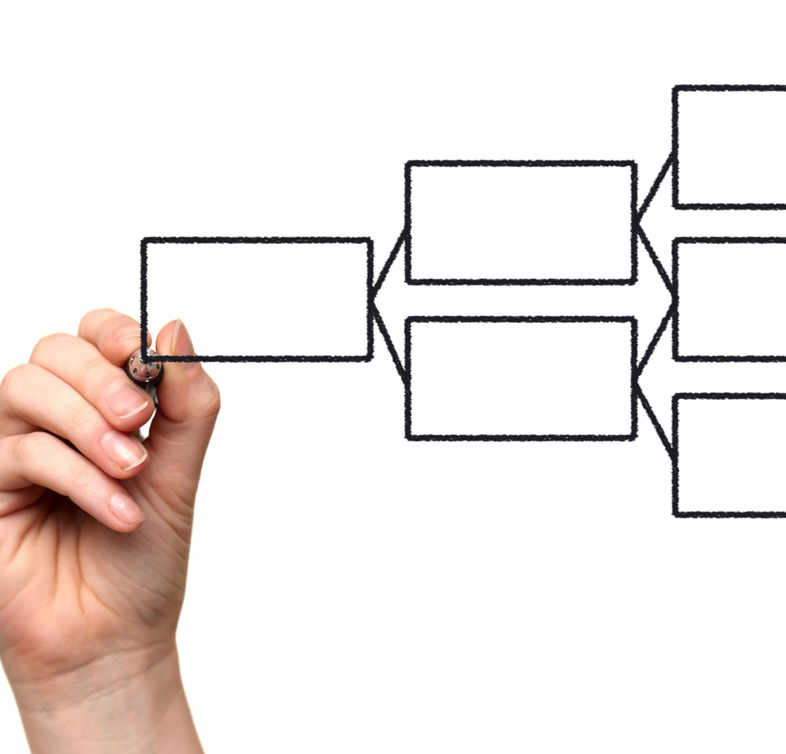
STAR Method Framework
Situation Context
Defines the background or scenario setting the stage for the story to be told.
Task Definition
Describes the goal or responsibility the individual had within the scenario.
Action Steps
Explains the specific steps taken to resolve the issue, showing problem-solving skills.
Result Outcome
Summarizes the measurable outcome or impact achieved from the actions taken.
Notes:
This slide introduces the STAR method—Situation, Task, Action, Result—as a structured framework for answering behavioral interview questions clearly and confidently. Situation refers to setting the context of the story, such as a user support challenge from a previous job. Task defines the goal or responsibility the learner had in that scenario. Action explains the steps taken to resolve the issue, which is often the most important part for hiring managers because it demonstrates thought process and troubleshooting skills. Result describes the outcome, ideally quantified or articulated in a measurable way. The slide should use a visual diagram showing the four components connected in a flow, helping learners see how the STAR method guides them through a complete and compelling narrative. This structure is particularly valuable for adult learners who may otherwise provide long, unfocused answers. The STAR method helps ensure responses are concise, relevant, and highlight problem‑solving abilities. In IT and cybersecurity roles, using STAR helps candidates articulate steps such as diagnosing system issues, communicating updates to users, escalating appropriately, or implementing security protocols. The instructor can reinforce that STAR responses don’t need to be perfect—they simply need to be clear and demonstrate capability.

Slide 14
STAR in Action
Notes:
STAR Method Example

Slide 15

STAR Method Example
Situation Context
A busy IT support environment with multiple user issues creates a high-pressure setting for problem resolution.
Task Definition
The task is to quickly restore user access to a critical application while ensuring clear communication.
Action Steps
Steps include verifying credentials, checking settings, resetting accounts, documenting work, and following up with users.
Result Achieved
User access is restored promptly, productivity resumes, and positive feedback is received from supervisors.
Notes:
This slide provides a practical STAR example tailored to an entry‑level IT support role so learners can visualize how the framework works. The example might describe a time when a user could not access a critical application. The Situation might involve a busy support environment with multiple tickets pending. The Task could be to restore user access quickly while maintaining communication. The Action would detail steps such as verifying credentials, checking group policy settings, resetting the account, documenting actions, and following up with the user—all essential components of IT troubleshooting. The Result might highlight how the user regained access promptly, productivity was restored, and the candidate received positive feedback from a supervisor. Presenting a realistic example helps learners understand the depth and detail expected in a strong STAR response. It also demonstrates that even simple tasks—like resolving login issues—can showcase problem‑solving, communication, and customer service skills. Adult learners who worry they lack “big” stories benefit from seeing that everyday experiences can be powerful interview examples when structured effectively. The instructor can encourage students to take notes and begin thinking of their own similar support scenarios or transferable experiences.

Slide 16
Interview Story Development
Notes:
Building a Story Bank

Slide 17

Building a Story Bank
Purpose of a Story Bank
A personal story bank prepares candidates with adaptable examples for various behavioral interview questions. It reduces anxiety and boosts confidence.
Story Themes to Cover
Stories should cover themes like teamwork, problem-solving, communication, and reliability for versatile interview answers.
Story Adaptability
One story can be reshaped to address multiple questions, such as conflict resolution or handling pressure.
Maintaining the Story Bank
Keeping stories in digital notes or journals helps refine narratives and ensures ongoing interview preparation.
Notes:
This slide emphasizes the value of building a personal story bank—three to five structured examples that candidates can adapt to various behavioral questions. A story bank helps learners feel prepared, reduces interview anxiety, and ensures they have meaningful experiences ready to share, even if those experiences come from non‑IT jobs. Stories can include times when learners resolved a conflict, helped a difficult customer, solved a technical or logistical issue, or adapted to a sudden change in priorities. This slide encourages students to categorize stories by themes such as teamwork, problem‑solving, communication, and reliability. The instructor may also remind learners that a single story can be reshaped to answer multiple questions. For instance, a customer service challenge from retail can be used for questions about conflict resolution, handling pressure, or going above and beyond. Encouraging learners to maintain their story bank in digital notes or a written journal helps them refine their narratives over time. By visually expressing this concept—perhaps through a folder or toolbox icon—the slide reinforces that story preparation is a long‑term investment in interview success rather than a one‑time exercise.

Slide 18
Transferable Skills
Notes:
Translating Non‑IT Experience

Slide 19
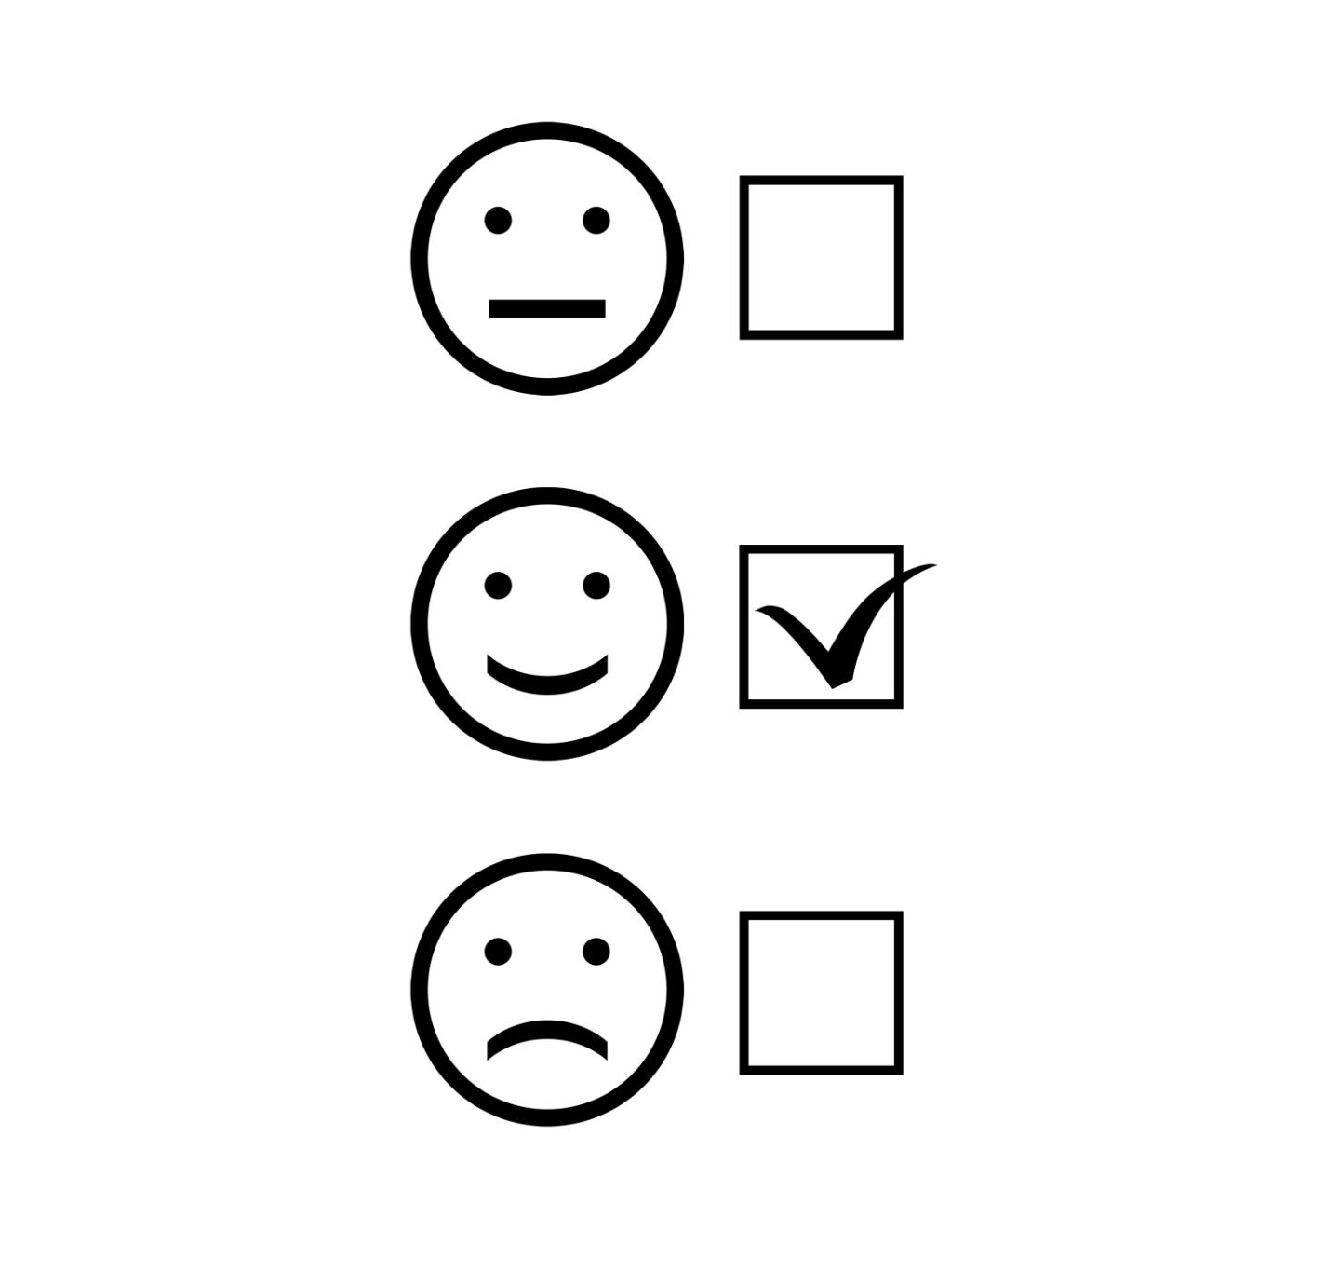
Translating Non‑IT Experience
Retail Skills to IT Support
Retail experience builds communication, patience, and customer service skills key for help desk and Tier 1 support roles.
Logistics to Systems Thinking
Logistics roles develop process orientation and documentation habits vital for IT systems management and troubleshooting.
Military Experience in Security
Military backgrounds demonstrate discipline, teamwork, and high-pressure comfort valued in security operations roles.
Customer Support to Troubleshooting
Customer support experience aligns with troubleshooting, conflict resolution, and empathy for end users.
Notes:
This slide explains how learners can translate experience from fields like retail, logistics, military service, or customer support into the language of IT and cybersecurity roles. Many adult learners underestimate how valuable their past experience is; this slide helps reframe that mindset. Retail roles build customer service, patience, and communication—skills essential for help desk and Tier 1 support positions. Logistics roles develop process orientation, documentation habits, and familiarity with systems thinking. Military experience can demonstrate discipline, adherence to procedures, teamwork, and comfort with high‑pressure environments—attributes appreciated in security operations roles. Customer support backgrounds often align directly with troubleshooting workflows, conflict resolution, and empathy for end users. This slide encourages learners to identify the core skill in their past experience and map it to IT responsibilities such as ticket management, user communication, escalation paths, or incident prevention. Visuals may include side‑by‑side icons showing a past skill paired with an equivalent IT skill. The instructor can guide students through short prompts to help them rewrite their experience in IT‑appropriate terminology.

Slide 20
Career Narratives
Notes:
Explaining Career Pivots

Slide 21

Explaining Career Pivots
Positive Framing of Pivots
Candidates should frame career pivots positively by clearly articulating motivations and connecting past experience to future goals.
Highlighting Motivations
Focus on motivations like interest in technology, desire for growth, or curiosity about cybersecurity during interviews.
Demonstrating Commitment
Emphasize proactive steps like certifications, training, and hands-on labs to show dedication to the new career.
Crafting a Concise Narrative
Create a clear and concise narrative that shows self-awareness, clarity, and forward momentum without justifying past decisions.
Notes:
This slide helps learners understand how to frame career pivots positively during interviews. Many adult learners transitioning into IT worry that their non‑technical backgrounds may appear inconsistent, but employers increasingly value diverse career paths when candidates can articulate their reasoning clearly. The slide explains that candidates should focus on motivations such as interest in technology, desire for stable career growth, curiosity about cybersecurity, or previous informal troubleshooting experience. It also encourages emphasizing proactive steps taken—such as pursuing certifications, completing training programs, or hands‑on labs—to demonstrate commitment. A successful pivot explanation connects past strengths with future goals, showing that the transition is intentional and well‑planned. Visual elements may include arrows or pathway graphics to symbolize career direction. The instructor can model sample pivot statements and help learners craft their own concise narrative. The goal is not to justify past decisions but to show clarity, self‑awareness, and forward momentum.

Slide 22
Addressing Gaps
Notes:
Explaining Employment Gaps

Slide 23

Explaining Employment Gaps
Acknowledging Employment Gaps
Candidates should acknowledge employment gaps clearly and briefly to maintain transparency with employers.
Providing Factual Reasons
Briefly explaining the reason for gaps by highlighting family, health, or educational causes reassures employers.
Highlighting Productive Activities
Emphasize constructive activities during gaps like volunteering, coursework, or skill development to demonstrate growth.
Maintaining Professionalism
Focus on professionalism and confidence rather than oversharing personal details during the interview.
Notes:
This slide provides students with a simple and effective structure for addressing employment gaps confidently during interviews. Employment gaps are common—especially among adult learners, parents, veterans, and individuals who have faced health or economic challenges. Employers generally accept gaps when candidates explain them clearly and briefly while emphasizing what they learned or how they stayed productive. The recommended script includes acknowledging the gap, providing a brief, factual reason, and highlighting constructive activities during that period—such as coursework, caregiving responsibilities, volunteering, or skill development. This slide reassures learners that they do not need to overshare personal details; professionalism and confidence matter more than specifics. Visuals might include a simple timeline to emphasize continuity and forward movement. The instructor may share examples like: “During this period I focused on family responsibilities, and once that stabilized I completed IT training and earned industry certifications. I’m now fully ready to re‑enter the workforce.” This helps learners understand how to maintain a positive tone while remaining honest.

Slide 24
Self‑Assessment Questions
Notes:
Strengths and Weaknesses

Slide 25

Strengths and Weaknesses
Highlighting Relevant Strengths
Candidates should emphasize strengths that support technical and customer tasks, such as patience and analytical thinking.
Assessing Weaknesses Authentically
Employers look for self-awareness and willingness to improve through real, manageable growth areas like time management.
Balancing Strengths and Weaknesses
A balanced response shows authenticity without red flags by pairing weaknesses with clear improvement steps.
IT Examples for Job Fit
Examples including methodical troubleshooting and seeking help demonstrate maturity and alignment with IT roles.
Notes:
This slide explains what employers are truly evaluating when they ask about strengths and weaknesses. Strengths allow candidates to highlight qualities that support technical and customer‑facing tasks—such as patience, analytical thinking, communication, or curiosity. Employers want strengths that align with IT workflows, not generic or inflated claims. Weaknesses, meanwhile, help employers assess self‑awareness, humility, and willingness to improve. A strong weakness response should focus on a real, manageable area for growth—such as time management or over‑documenting technical notes—paired with clear steps the candidate is taking to improve. This balance ensures authenticity without raising red flags. Visuals may include balanced scales or icons representing growth and stability. The instructor can encourage students to develop a strength and weakness that reflect their personal experience and match job expectations. IT‑related examples might include strengths in methodical troubleshooting or weaknesses like needing to grow more comfortable asking for help from senior technicians. Framing weaknesses as part of ongoing professional development helps convey maturity.

Slide 26
Accountability and Growth
Notes:
Discussing Mistakes or Failures

Slide 27

Discussing Mistakes or Failures
Acknowledging Accountability
Demonstrating honesty and responsibility when discussing mistakes builds trust and professionalism.
Learning from Errors
Focus on lessons learned and how procedures improved following a mistake to show growth.
Role-Specific Examples
Use examples from relevant roles like IT support or cybersecurity to contextualize mistakes clearly.
Overcoming Fear
Framing mistakes as learning experiences encourages maturity and reduces fear around discussing failures.
Notes:
This slide teaches learners how to discuss mistakes or failures in a way that demonstrates accountability and growth. Employers do not expect perfection, especially from entry‑level candidates; instead, they value honesty, humility, and reflection. The slide explains that a strong response includes describing the situation briefly, outlining the mistake, acknowledging responsibility, and focusing primarily on what was learned and how procedures were improved going forward. In IT support roles, mistakes might include miscommunicating an issue, escalating too late, or misunderstanding a user request. In cybersecurity roles, errors may involve misconfigurations or overlooking early signs of an alert. What matters most is demonstrating how the experience strengthened the candidate’s skills, attention to detail, or communication. This slide may use visuals such as growth arrows or a before‑and‑after comparison. Adult learners often fear discussing mistakes, but framing them as learning experiences showcases professionalism and maturity. The instructor can provide example responses and encourage students to reflect on moments when they improved their process.

Slide 28
Interview Preparation
Notes:
Interview Preparation Checklist

Slide 29

Interview Preparation Checklist
Research and Question Review
Research the company and role thoroughly; review common technical and behavioral interview questions.
STAR Stories and Confidence
Select and rehearse two to three STAR stories to share; practice confidence‑building statements to reduce anxiety.
Professional Attire and Setup
Prepare appropriate professional attire; ensure reliable internet and device setup for virtual interviews.
Organize Documents and Notes
Organize resume copies and interview notes neatly for easy access during the interview process.
Notes:
This slide provides a visual checklist covering essential preparation steps before an IT or cybersecurity interview. Categories may include: researching the company and role, reviewing common technical and behavioral questions, selecting two or three STAR stories to rehearse, preparing professional attire, ensuring reliable internet and device setup for virtual interviews, and organizing resume copies or notes. It may also include mental preparation strategies such as practicing confidence‑building statements or reviewing accomplishments. Visual elements such as checkmarks, icons, or sectioned boxes help learners quickly understand the structure. The slide highlights that preparation reduces anxiety, increases clarity, and helps candidates present themselves professionally. The instructor can emphasize that even small tasks—like practicing how to introduce oneself or preparing questions for the interviewer—significantly impact how confident and competent a candidate appears. This checklist serves as a repeatable process students can use for every interview moving forward.

Slide 30

Common Interview Mistakes
Rambling Answers
Rambling answers show lack of preparation and unclear thinking; use structured frameworks like STAR to stay focused.
Vague or Generic Stories
Providing vague or generic stories makes candidates seem inexperienced; specific examples demonstrate real skills.
Lack of Preparation
Not researching the company or failing to ask thoughtful questions signals low interest and unprofessionalism.
Negative or Unengaged Behavior
Speaking negatively about past employers or lacking eye contact reduces interview impact and shows poor engagement.
Notes:
This slide outlines the most common interview mistakes that can hurt candidate performance. Rambling answers often signal a lack of preparation or unclear thinking, so the slide encourages students to use structured frameworks like STAR to remain focused. Vague stories or generic claims can make candidates appear inexperienced, so learners are encouraged to provide specific examples that demonstrate real skills. A lack of preparation—such as not researching the company or failing to bring thoughtful questions—signals low interest or unprofessionalism. Additional pitfalls may include speaking negatively about previous employers, failing to maintain eye contact in virtual interviews, or appearing overly rehearsed without genuine engagement. Visuals might include caution symbols or icons illustrating do’s and don’ts. The instructor can reinforce that most mistakes are preventable with practice and awareness. Discussing these pitfalls helps students identify their own tendencies and prepare more strategically for future interviews.

Slide 31
Interactive Skill Building
Notes:
Interactive Practice Activity

Slide 32

Interactive Practice Activity
Behavioral Interview Practice
Students practice answering behavioral questions using the STAR method to build structured responses.
Active Engagement Benefits
Active participation helps learners reinforce knowledge through practical application rather than passive listening.
Peer Feedback and Discussion
Peer feedback and group discussions help refine responses and identify strong personal examples.
Notes:
This slide introduces an interactive activity where students practice answering a behavioral interview question using the STAR method. The instructor may present a prompt such as: “Tell me about a time you had to troubleshoot an issue under pressure.” Students work individually or in pairs to outline their response using the four STAR components. The slide encourages learners to reference their story bank and apply the structure learned earlier in the workshop. The activity is designed to build confidence, highlight areas where students may need more clarity, and give them firsthand experience constructing a complete, concise narrative. Adult learners benefit greatly from active engagement because it reinforces learning through practical application rather than passive listening. Including icons or diagrams can guide learners step‑by‑step through the activity. The instructor may facilitate peer feedback or group discussion to help students refine their responses and identify strong examples already present in their personal backgrounds.

Slide 33
Summary and Reflection
Notes:
Key Takeaways

Slide 34

Key Takeaways
Interview Preparation Importance
Effective interviews require thorough preparation, storytelling skills, and clear communication.
Using Storytelling Frameworks
Building a story bank and applying the STAR method helps structure responses for behavioral questions.
Articulating Transferable Skills
Highlighting skills from past roles boosts confidence in IT and cybersecurity job interviews.
Continuous Skill Refinement
Ongoing practice, company research, and awareness of common mistakes enhance interview success.
Notes:
This slide summarizes the core lessons from the workshop to reinforce retention and confidence. Students are reminded that strong interview performance stems from preparation, storytelling, and clarity. Building a story bank ensures they are ready for behavioral questions, while frameworks like the STAR method help them communicate their experiences effectively. The slide highlights that transferable skills from previous roles are valuable in IT and cybersecurity positions when articulated thoughtfully. Learners should leave understanding how to explain career pivots and employment gaps with professionalism and confidence. The slide also reinforces the importance of practicing responses, researching companies, and staying mindful of common interview mistakes. By presenting these takeaways in a visual, easy‑to‑scan format, learners can quickly review key points after the workshop. The instructor can encourage students to continue refining their interview skills as part of an ongoing professional development strategy.

Slide 35
Encouragement and Closure
Notes:
Final Encouragement

Slide 36

Final Encouragement
Interview Confidence Growth
Interviewing skills improve with practice, boosting confidence through refined stories and common question familiarity.
Value of Unique Experiences
Learners are reminded that their unique career experiences are valuable and strengthen their interview communication.
Learning from Setbacks
Setbacks during job searching are normal and each interview offers insights for improvement.
Positive Momentum
Encouraging visuals emphasize positive momentum, motivating learners toward success in IT and cybersecurity careers.
Notes:
The final slide provides motivating encouragement to help learners feel empowered as they move toward upcoming interviews. It emphasizes that interviewing is a skill that improves with practice, and that confidence grows as candidates refine their stories and gain familiarity with common questions. Adult learners, particularly those transitioning careers, often underestimate their strengths; this slide reminds them that their unique experiences are valuable and that preparation equips them to communicate effectively. The instructor may reinforce that setbacks are normal in job searching, and each interview provides insight into what to improve next time. The slide can include uplifting visuals—such as upward‑moving arrows or success‑themed icons—to reinforce positive momentum. By closing on an encouraging note, students leave the workshop feeling supported, motivated, and ready to apply what they have learned. They are reminded that every interview is an opportunity to showcase growth, resilience, and readiness for a future in IT or cybersecurity.

